Slide 1
DSM Criteria: Anxiety Disorders
EDUC 3602

Slide 2
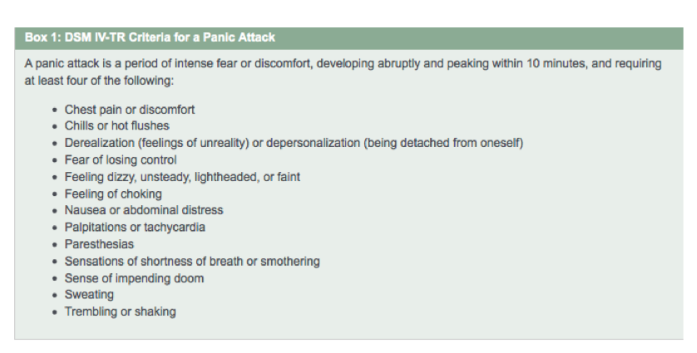
DSM: Panic Attack

Slide 3
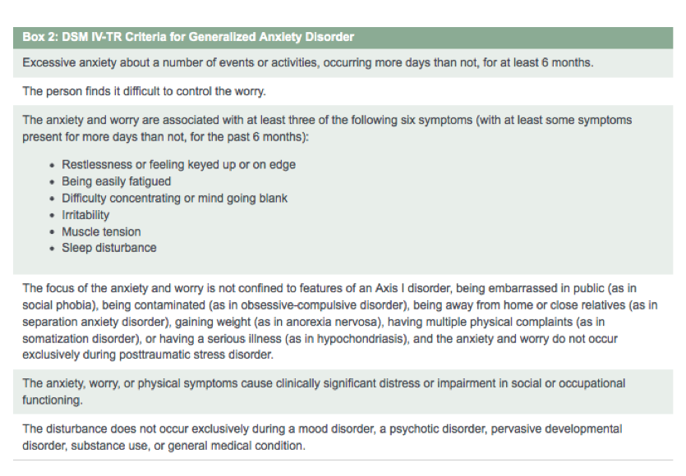
DSM: Generalized Anxiety Disorder

Slide 4
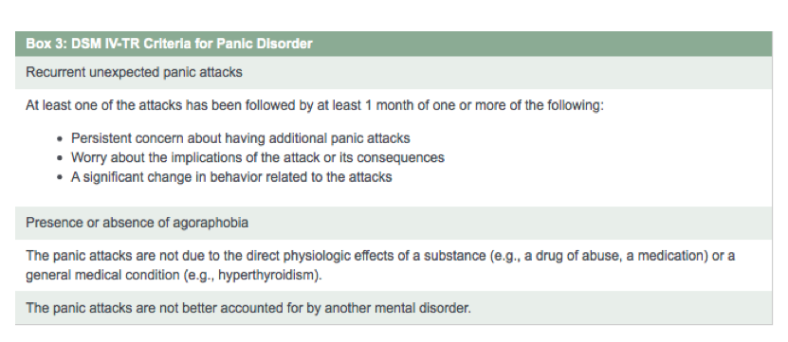
DSM: Panic Disorder

Slide 5
DSM: Agoraphobia

Slide 6
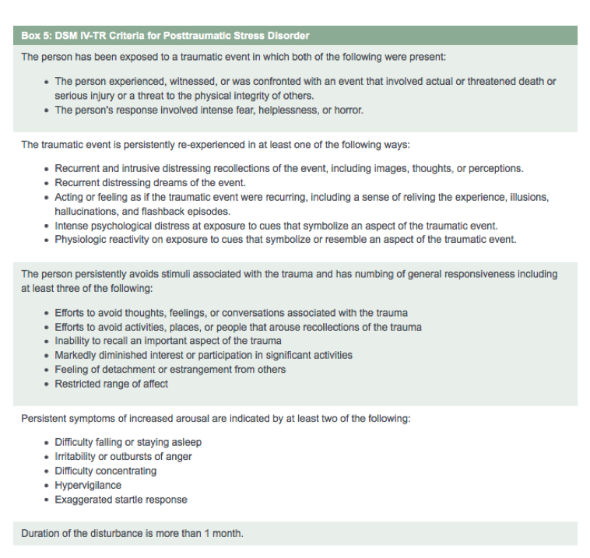
DSM: PTSD

Slide 7
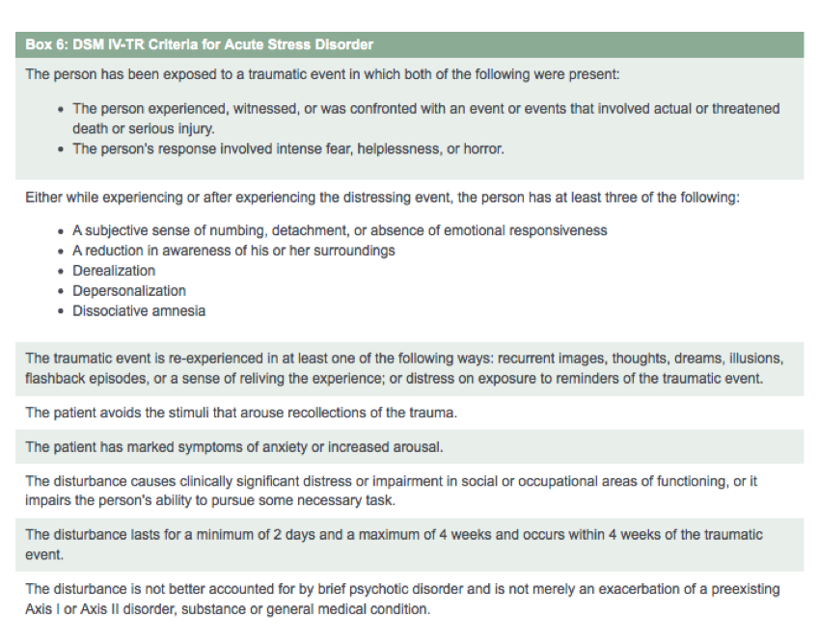
DSM: Acute Stress Disorder

Slide 8
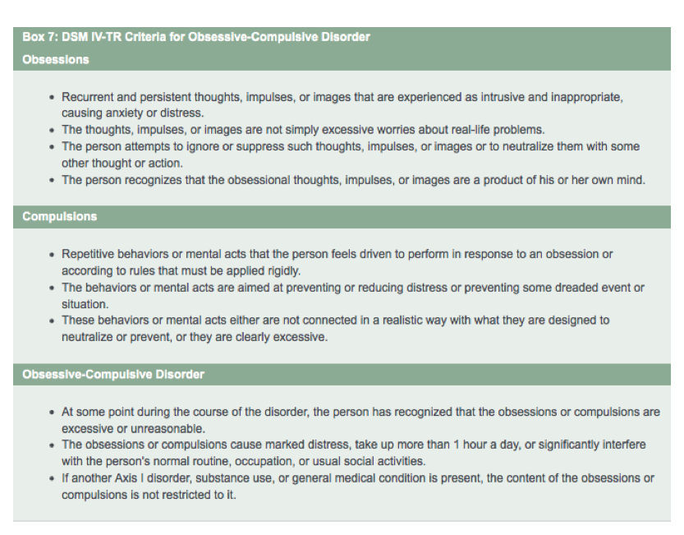
DSM: Obsessive-Compulsive Disorder

Slide 9
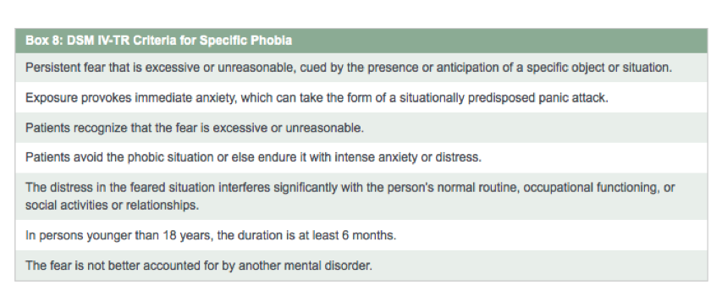
DSM: Specific Phobia

Slide 10
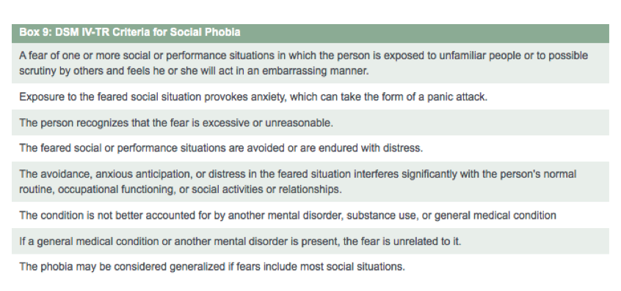
DSM: Social Phobia

